Slide 1
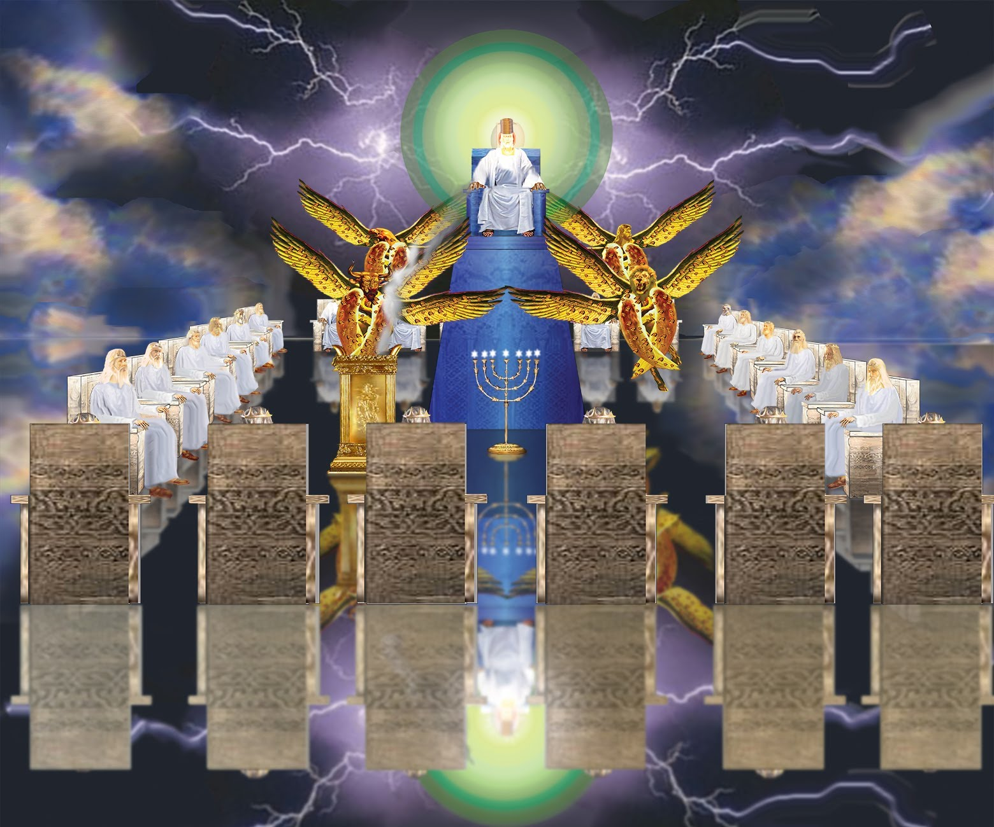
Revelation 4:1ff

Slide 3
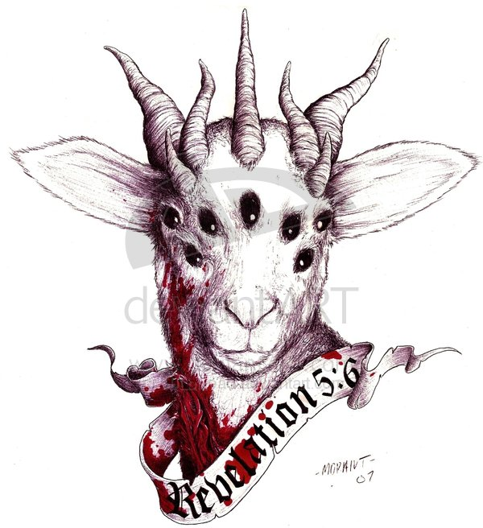
Revelation 5:1
“And I saw between the throne (with the four living creatures) and the elders a Lamb standing, as if slain, having seven horns and seven eyes, which are the seven Spirits of God, sent out into all the earth.” (Revelation 5:6, NASB)

Slide 4
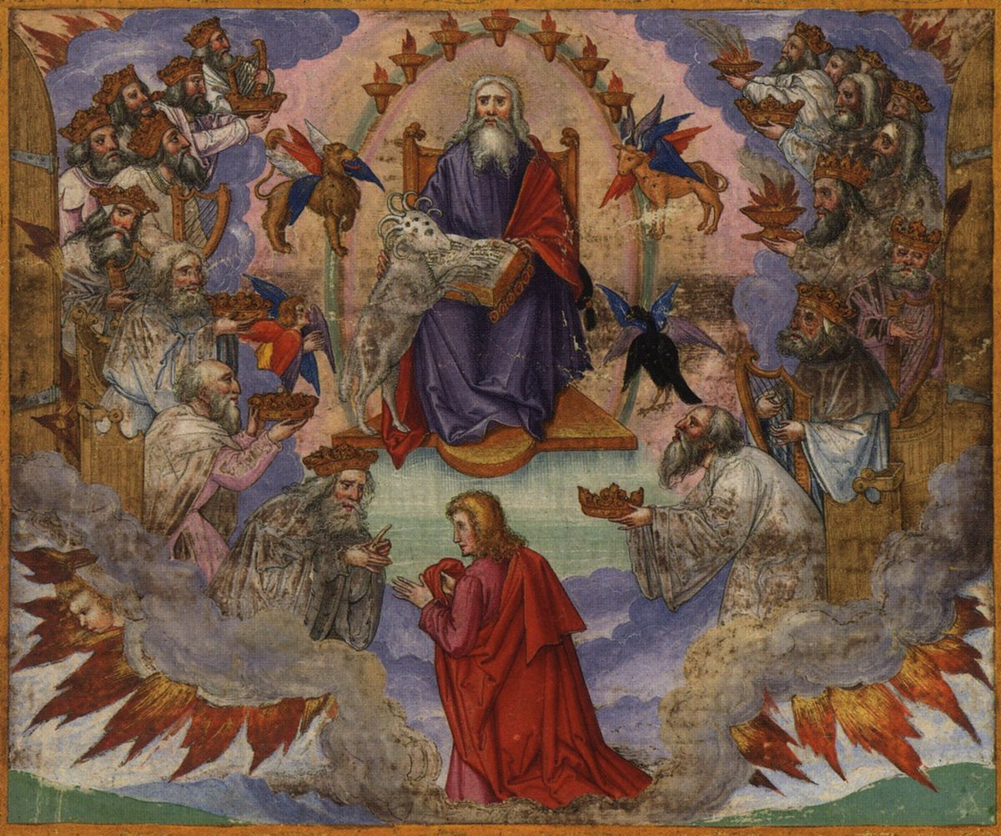
“And He came, and He took it out of the right hand of Him who sat on the throne.” (Revelation 5:7, NASB)

Slide 5
