Slide 1
Notes:
HAPPY MOTHER’S DAY LADIES!!
I was just thinking about my Mother & Father. Loved them both. But REALLY LOVED my mother. All the things she did for me but mostly it was how much she cared for me.
Sneezing example.
If I was sick, she stayed up with me, if I needed help with something, she gave it.
Thank you to all women for everything you do to make our lives so much better! This is one holiday I don’t mind! Sweetest Day ex!

Slide 2
HAPPY MOTHER’S DAY
Notes:
Happy Mother’s Day – you’ve earned it!
Over the years we’ve done drawings
One question today though, no prizes
Who has been a mother for more than 50 years?
Mother’s Day Quotes:
I remember my mother's prayers and they have always followed me. They have clung to me all my life. Abraham Lincoln
The most important thing a father can do for his children is to love their mother. Theodore Hesburgh
There is nothing in the world of art like the songs mother used to sing. Billy Sunday
"Try praising your wife even if it does frighten her at first." - Billy Sunday
"If evolution is true, how come mothers still have only two hands?" - Spotted on a church sign

Slide 3
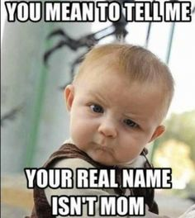

Slide 5
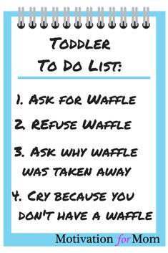

Slide 6
I. A mother called by God submits completely to God's will
II. A mother called by God does not have to be perfect
III. A mother called by God never relinquishes the title
Proverbs 31 – different take
Conclusions
Notes:
I

Slide 7
Han
handout
HANDOUT
Notes:
Read from Handout
Comment

Slide 8
PROVERBS 31
Notes:
I

Slide 9
CONCLUSIONS

