Slide 1
THE LIGHT OF THE WORLD
THREE PROMISES OF COMFORT THROUGH THE DELIVERER

Slide 3
ISAIAH CHAPTER 9
A LITTLE BIT OF HISTORY

Slide 4
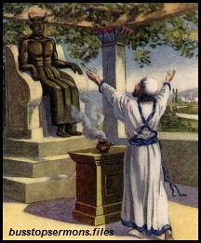
Ahaz did
evil in the sight of the Lord
and was very afraid of Israel and Syria

Slide 5
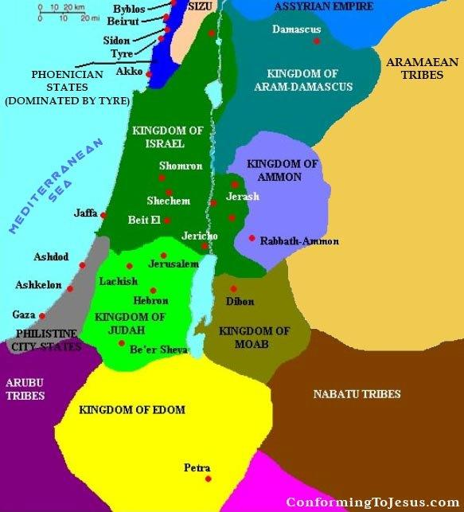

Slide 6
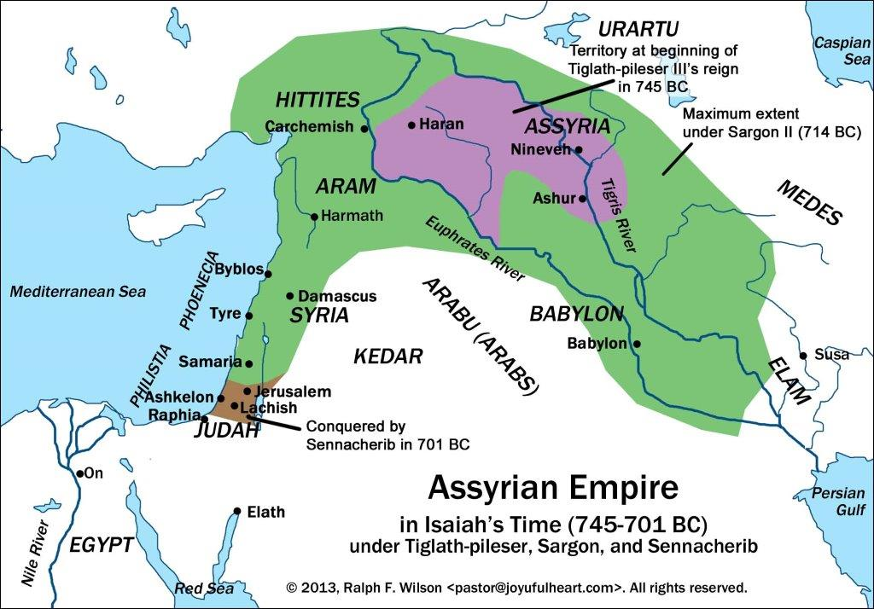

Slide 7
THREE PROMISES OF COMFORT THROUGH THE DELIVERER
I PROMISE # 1: THE GALILEE WILL BE DELIVERED
A DELIVERED FROM THE LORD'S CONTEMPT
B MADE GLORIOUS

Slide 8
II PROMISE# 2: THE PEOPLE WILL SEE A GREAT LIGHT
A THEY WILL INCREASE
1 In Number
2 In Happiness
3 In the presence of the LORD
4 In the Harvest
5 In Joy
B THEIR OPPRESSORS WILL BE BROKEN
C NO MORE WAR

Slide 9
III PROMISE# 3: GOD WILL BE WITH US IN THE FLESH
A A SON OF MAN
B THE SON OF GOD
C BRINGER ORDER THROUGH RIGHTEOUSNESS AND JUSTICE
D CALLED BY MAJESTIC NAMES
1 WISE
2 DIVINE
3 A FATHER WHO NEVER LEAVES
4 GRACIOUS
D EVER INCREASING
E KING DAVID'S LEGITIMATE HEIR
F EVERLASTING
G WIELDER OF THE AUTHORITY OF JAHWEH

