Slide 1
Mark 9:35-37
Greatness in the Kingdom
Of Heaven

Slide 2
According to the Huffpost (the website of the Huffington Post) There are 9 characteristics of people destined to greatness.
https://www.huffingtonpost.com/ayodeji-awosika-/9-common-characteristics-of-people-destined-for-greatness_b_9644312.html

Slide 3
1 they're not humble 2 they're irrational 3 they don't believe in inspiration 4 they don't live balanced lives 5 they're lucky 6 they know that personality traits can be learned 7 they visualize they're success to the point of certainty 8 they ask questions 9 they never fail

Slide 4
JESUS REVEALS 3
QUALIFICATIONS OF GREATNESS IN THE KINGDOM OF HEAVEN

Slide 5
MARK 9:35
“IF ANYONE WANTS TO BE FIRST, HE SHALL BE LAST OF ALL, AND SERVANT OF ALL.”
Here’s 2 of them

Slide 6
1 DESIRE (wish)
I Tim 3:1 – If any man seeks the pastorate He lusts after a good work.

Slide 7
2 HUMBLE MINISTRY
LIKE
PAUL and APOLLOS
I Cor 4:9 ff

Slide 8
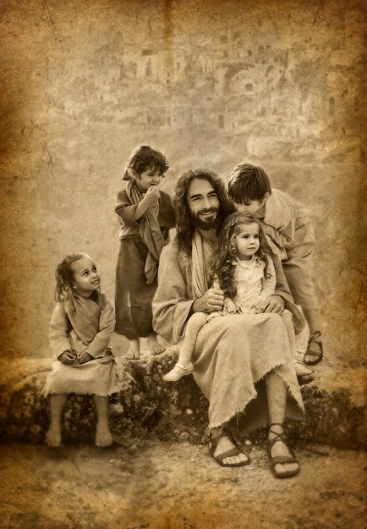
Jesus shows ministry to the least is greatest

Slide 9
If you truly want to do great things for the Lord, ministering to the least is the best way!

Slide 10
3 GREAT CAUTION
““WHOEVER RECEIVES ONE CHILD LIKE THIS IN MY NAME RECEIVES ME; AND WHOEVER RECEIVES ME DOES NOT RECEIVE ME, BUT HIM WHO SENT ME.”” MARK 9:37, NASB95

Slide 11
A “RECEIVE” MEANS TO WELCOME
B SERVING CHILDREN IS SERVING THE LORD HIMSELF IN THE PERSON OF A CHILD.
C. ALL THE GOSPEL ACCOUNTS GIVE THE SAME WARNINGS ABOUT SERIOUS REPERCUSIONS IN DEALING WITH "HIS CHILDREN"

Slide 12
SMILE
ALWAYS REMEMBER Children may not remember what you say, but they will always remember how you make them feel.

