Slide 1
THIS IS CHRISTMAS

Slide 2
"That most wonderful time of the year." Means a lot of things to the world, presents, family get-togethers, food, giving presents and of course presents and above all else, receiving presents.

Slide 3
BUT TO CHRISTIANS IT MEANS JESUS

Slide 4
This is Christmas.
Galatians 4:4-7
4 But when the fullness of the time had come, God sent forth His Son, born of a woman, born under the law, 5 to redeem those who were under the law, that we might receive the adoption as sons.
6 And because you are sons, God has sent forth the Spirit of His Son into your hearts, crying out, “Abba, Father!” 7 Therefore you are no longer a slave but a son, and if a son, then an heir of God through Christ. Galatians 4:4-7

Slide 5
2 REASONS JESUS THE SON WAS BORN

Slide 6
#1 - TO REDEEM US
But when the fullness of the time had come God sent forth His Son, born of a woman, born under the law, 5 to redeem those who were under the law.
A.BORN AT THE PROPER TIME
B.BORN OF A WOMAN
C.BORN UNDER THE LAW

Slide 7
# 2 TO MAKE YOU, ME, JESUS AND GOD THE FATHER, TOGETHER, ONE FAMILY

Slide 8
BY INDWELLING US WITH HIS SPIRIT
“But this is the covenant that I will make with the house of Israel after those days, says the Lord: I will put My law in their minds, and write it on their hearts; and I will be their God, and they shall be My people.
No more shall every man teach his neighbor, and every man his brother, saying, ‘Know the Lord,’ for they all shall know Me, from the least of them to the greatest of them, says the Lord. For I will forgive their iniquity, and their sin I will remember no more.” (Jeremiah 31:33,34, NKJV)
B. AND MAKING US HEIRS
BREAKING OUR BONDAGE
MAKING US FAMILY
“For the promise that he would be the heir of the world was not to Abraham or to his seed through the law, but through the righteousness of faith.” (Romans 4:13, NKJV)
AND
“that the Gentiles should be fellow heirs, of the same body, and partakers of His promise in Christ through the gospel,” (Ephesians 3:6, NKJV)

Slide 9
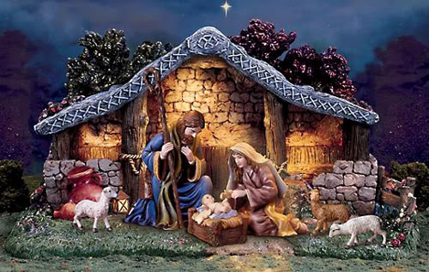
MERRY CHRISTMAS
AND
BLESSED NEW YEAR
FROM ED, JUDY AND FAMILY

